Slide 1

Value Drivers Ice Hockey Media Rights
E.H.C Hockey Business Forum
Stockholm 11 November, 2017

Slide 2
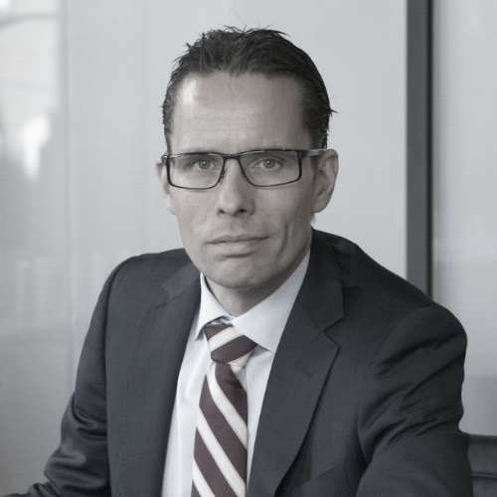
Jonas persson
Positions
CEO, Commercial Sports Media
Chairman Sportway
Partner Digital Media Center
Vice president Kalmar FF
Co writer: “Sport Marketing” / www.sport-marketing.se
Main area of experience: Media rights and TV sport production
Background
Sport journalist from Kalmar in Sweden
International business and administration in Lund and St Gallen 1988-92 (MBA)
Founder of IEC in Sports in 1994
2

Slide 3
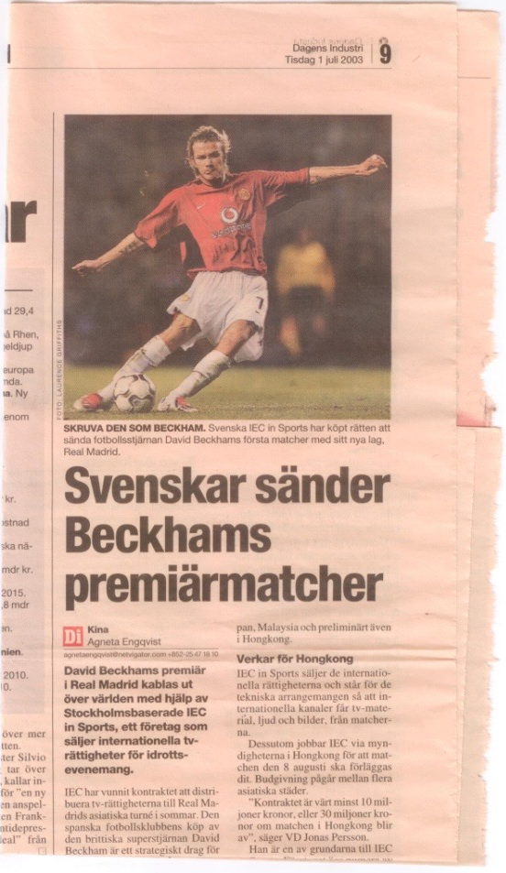
milestones
Important events
1994 | IEC in Sports was founded as the first specialised sport media rights agency in northern Europe. Initial succesful business cases included distribution of European events into the growing Asian markets.
2001 | Sales of IEC in Sports into Sport Resource Group, which was a listed company in the UK.
2003 | MBO of IEC in Sports and start of global expansion with offices in Dubai, Hong Kong, London, Lausanne, Montreal and Sydney. 300 sporting events yearly in the portfolio. Demand for live sports content exploded when media went digital.
2007 | Sale of IEC in Sports to Lagardere. Expansion into event management and premium sports content.
2012 | Departure from Lagardere after change of management. Advisory position at Stella Advisors, a Nordic investment bank. Launch of HBO in the Nordics.
2015 | Foundation of Commercial Sports Media focusing on premium sports rights segment.
3

Slide 4


Today`s position in the market
Relevant information is key for a succesful advisory role
 | A European leader in media and technology investment banking.
DMC | Full service post production service company in Stockholm and an incubator for spot and technology companies. DMC is a hub in a global sport infrastructure network and service clients all around the world.
 | Sportway is a youth sport live service platform. Experimental business approach in terms of low cost and high efficient production models. App development. Management of minor rights.
 | Advisory service in the premium sports rights segment. Clients are mainly primary rightsholders, such as ice hockey leagues.
4

Slide 5









































Sport Media Rights development
Political and technology changes over the past decades have increased demand for sport media rights
Sports Media Rights Development
Analogue /
Regulated markets
Cable and Satelite /
Privatization of media
Content Aggregators
Digital Media
and Telcos
OTT
Social Media
E-commerce
Demand for Sports Media Rights
5

Slide 6
Global rights value sport media rights
100% uplift in 12 years
Source: TV Sports Markets
6

Slide 7
























TV revenue from premier league (domestic)
Rapidly growing TV revenues in the Premier League (domestic UK rights)
GBPm
CAGR¹: 15.7%
Note 1: Compound annual growth rate
7

Slide 8
Tv-rights market – top 10 sports 2016
Footboll at the top
Source: TV Sports Markets
8

Slide 9
market drivers
There are a lot of market dynamics and further segmentation in the sport media rights the years ahead to be expected
Drivers
Impact
Macro Economics
Overall strong economical development in European and North American markets after the financial crises 2008.
TV rights value per capita is growing.
Consumers have more money to spend on media spending
Live Window
Relative to other entertainment programming and movies live sport stands out in search for exclusive viewership and customer loyalty. Live sports attract target groups that are otherwise difficult to reach. Young male audience.
Increased demand for live sports programming thanks to exclusivity
Demand for Sports Media Rights
Competition
A number of quickly expanding players have entered the rights markets in the past ten years. Local media companies have come under pressure from global and pan-continental players, ie Al Jazeera/BeIN and Discovery.
Increased license fees
Technology
Ways of consuming live sports have increased a lot in the past years with the use of smart phones, iPads, social media etc. In parallel the infrastructure for delivering of streamed sports have been further upgraded.
More ways to consume sports content
Sport Politics
Creation of different formats such as new tournaments and leagues within existing structures, ie CHL, Nations League in football, Diamond league in athletics.
More attractive sports content in the market
Supply for Sports Media Rights
Agency Market
More attractive sports content in the market
A lot of the creativity in the market place comes from the agencies, who are developing new concepts for events and hence new programming
9

Slide 10

































Live sport – traditional value chain challenged
B2C providers of live sport content
Traditional distributors
Rightsowners
Audio-visual technical service providers OB Production
Playout/managed service
providers
OTT
Sport media rights
management companies
10

Slide 11



Live sport – alternative or additional value chain
Rights owners
Offering of in house OTT services
Sport media rights
management companies
In depth coverage of a league or an event
Away to reach fans away from the home markets
Archive offering to fans and industry specialists
Niche programming around a league or a sport
Cost efficient way to get to know the end consumers

Slide 12
Sports media rights outlook for ice hockey
New entrants and increased competition will keep the sport and media rights market growing
1
Telco´s new Bundling
Global Players
2
Two major European telcos have entered into the ice hockey segment – Deutsche Telekom in Germany and Telia in Finland
Traditional media companies expand geographically, ie BeIN and Discovery. A way for icehockey to find new markets.
Niche players use new technology to reach niche markets.
3
OTT Technology
Further Segmentation
4
Primary rightsholders, ie ice hockey leagues, might look at launching their own services in primary or secondary markets
Market entrance costs will be for marketing as technology costs are likely to go down
Betting rights have become a significant revenue stream in many sports. Tennis is one of the best examples.
Social media.
12

Slide 13













CSM - Philosophy and track record
Philosophy
Track record
As a result of a more complex sports industry CSM was founded in order to assist rights holders in creating values and product development in the sport and media market. CSM provide professional advise to sport organisations and media companies
20 years ago there were only a dozen sport channels globally, whereas today there is a large amount of sports channels in every market and device (TV, tablet, mobile etc.). Multiple new digital outlets are being packaged with sports content.
In addition there are also a number of new suppliers that offers live sports to consumers, these include betting companies, telecom operators and consumer brands that are using live sports to position its brand simultaneously with building a media group
Sports and the need to ensure live sporting events have never been more important for the media sector
We have proved that this structure adds further value for rights holders and media companies
Stella EOC, a leading investment bank in the TMT space, owns 20% of CSM
All of CSM´s partners have been part of the rapid development, both within broadcasting and right exploitation. Together we offer a combination of knowledge in investment banking and more than 50 years combined experience from the sports rights industry
Companies that CSM has worked with include the following:
13

Slide 14
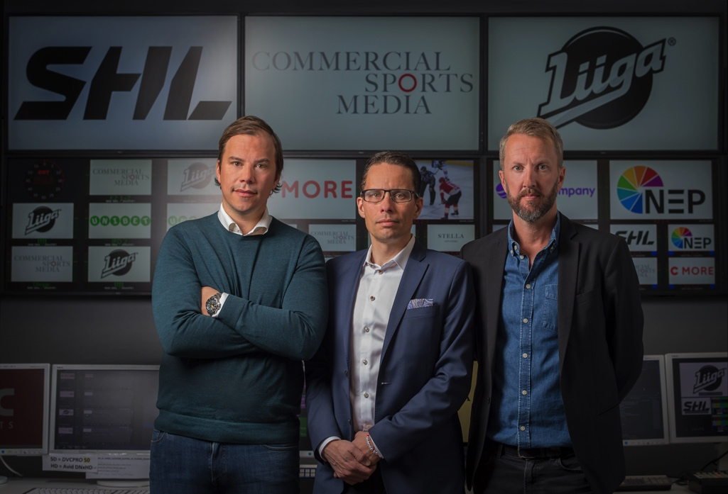
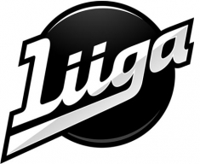

Recent ice hockey cases: shl and liiga
Swedish Hockey League and Liiga in Finland
Commercial Sports Media is combining working methods from investment banking with our experience from the sport media rights field. We focus on research, data, modelling and analyses. Hence we bring a structural process to the exploitation of the media rights.
In 2015 CSM was trusted to work as exclusive advisors to the Swedish Hockey League (SHL) and in 2016 to the Finnish Hockey League (Liiga) in the respective sales processes of media rights.
Key elements in the processes were the re-packaging of the rights to identify buyers in segments outside of the obvious ones. There was a continuous dialogue with the parties involved to reassure optimal value creation, including attractive exploitation plans.
In 2016 Swedish Hockey League (SHL) agreed a new media rights deal with Bonnier 2018/19-2023/24.
In 2017 the Finnish Hockey League (Liiga) agreed a new media rights deal with Telia 2018/19-2023/24. It is the first ever premium rights acquisition by a Telco in the Nordics.
14

Slide 15
Recent ice hockey cases: shl and liiga
Key takeaways
The market place prefer long duration of media rights contracts mainly due to quickly changing consumer behaviour, which is happening thanks to new technology.
Exclusive live rights are driving the value more than ever in the premium segment.
Important to include detailed exploitation plans in the process in order to manage the product in partnership with the buyer of the media rights.
In house knowledge in combination with a proven infrastructure for content management is very important to challenge the incumbent rightsholder.
Flexible attitude for commercial drivers are important, hence important to have a good balance and understanding between the sport and commercial aspects in a league.
Timing of the processes are key for success, hence important to be able to evaluate the competitive situations at relevant markets over time.
15

Slide 16
DRIVING media rights value
It is important to offer good conditions for all players to acquire the rights without lagging in the transistion phase between rights cycles
Existing rights
Keep certain rights windows non-exclusive, ie news, highlights, features.
Archive content provide a new player with instant access to historical highlights, the best goals, tackles, bloopers
Build the leagues digital presence
The leagues´and clubs´ total digital reach are an asset when negotiating media rights deals.
Extensive database
Do market research and build customer profiles in a database providing significant value for a potential new holder of the rights
Growth of CRM possible through ownership of arena WiFi and in-house ticketing system
Production guidelines
The leagues are recommended to invest in creating comprehensive and extensive production guidelines
These guidelines belong to the league and are included in the acquisition of the rights
Infrastructure
Camera platforms and television friendly arenas.
Arena fibre networks for instant and smooth delivery of content internally and externally.
Post production facilities
16

